Slide 1
Introduction to
Python Programming
1 - Output, variables and input.

Slide 2
Learning Goals/Objectives
Be able to read, comprehend, trace, adapt and create Python code that:
Outputs text to the console
Assigns data to variables
Gets input
Assigns input to variables.
Refers to variables in other statements such as ‘print’

Slide 3


What is a Computer?
=
Notes:
Explain that a computer/device is just a collection of switches that are connected together.
Early computers used valves as these switches, modern computers use electrical circuits.
The operation of these switches is controlled by sets of instructions called software.
When we program, we are creating software.
In this course we will be coding simple software.

Slide 4
Input
Data is collected and sent to the computer
Process
Carrying out instructions.
Output
Presenting the results of processing back to the user
Storage
Saving data that is not in use.
Notes:
Explain that computer operation can be simplified down to this diagram.
Describe what happens at each stage.

Slide 5
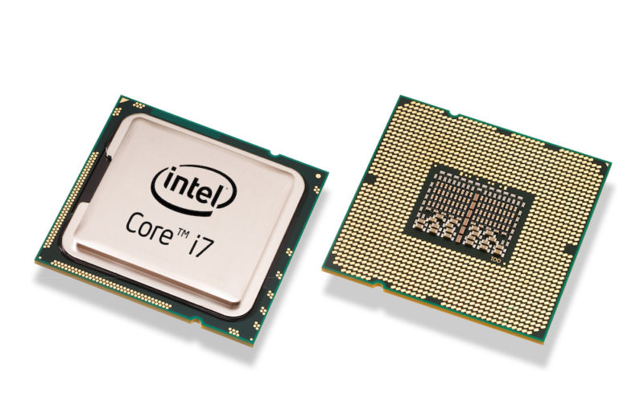
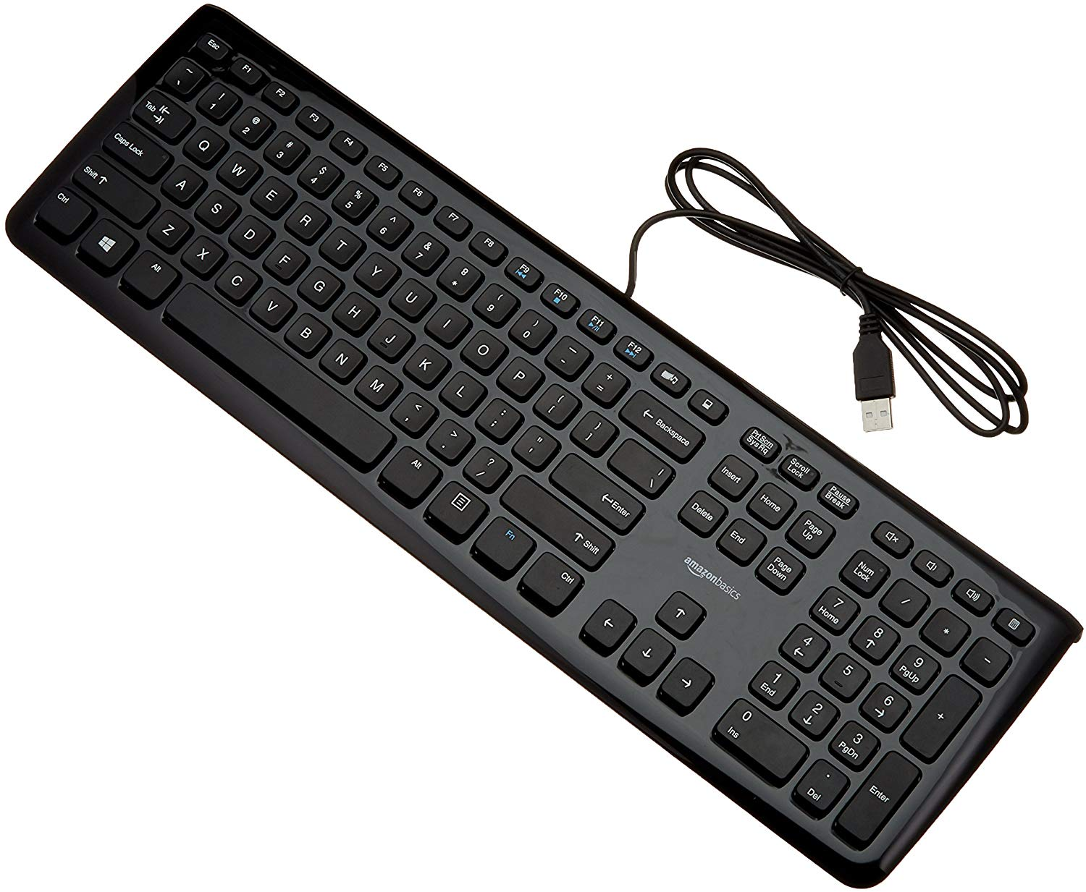
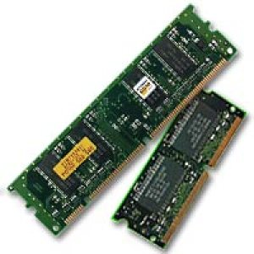


Notes:
Different pieces of hardware are used to perform the different functions in the previous diagram.

Slide 6
Input
Data is collected and sent to the computer
Process
Carrying out instructions.
Output
Presenting the results of processing back to the user
Storage
Saving data that is not in use.
Notes:
What other pieces of hardware can students think of? What category do they fit into?

Slide 7
Algorithms
"An algorithm is a sequence of instructions for a task"
Algorithm ≠ Computer Program
Notes:
Algorithms are a core concept of computer science. Being able to think step by step in a logical fashion is a key skill for being a good programmer.
Algorithms are not always for computers – pupils make this mistake a lot because they are in computing.
An algorithm is not always for a computer. ≠ means not equal to. Point this out to students.

Slide 8


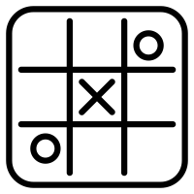
Algorithms In The Real World
Notes:
Lots of real world tasks have sequences of instructions.
A great way to get pupils thinking sequentially is to produce algorithms for everyday tasks.
Discuss why all of these activities need algorithms to represent them. What characteristics do they have in common?
Are any of these computerised tasks? Could they be?

Slide 9
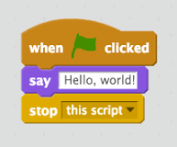
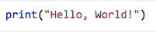
A Computer Program
Algorithms that are converted into code become computer programs.
Algorithm
OUTPUT "Hello, World"
Scratch
Python
Notes:
Explain how useful algorithms are for planning before coding.
Here we have the same basic algorithm – written in plain English.
The algorithm has been converted into 2 different languages - Scratch is a block based language (the commands are baked into the blocks, you just drag them into sequence). Python is a text based language (you type the commands in the correct sequence).
Computational thinking is the set of skills involved in creating algorithms for tasks/problems.
Programming is writing the code for your algorithms. Programming without having a clear idea of your algorithm is REALLY DIFFICULT!

Slide 10
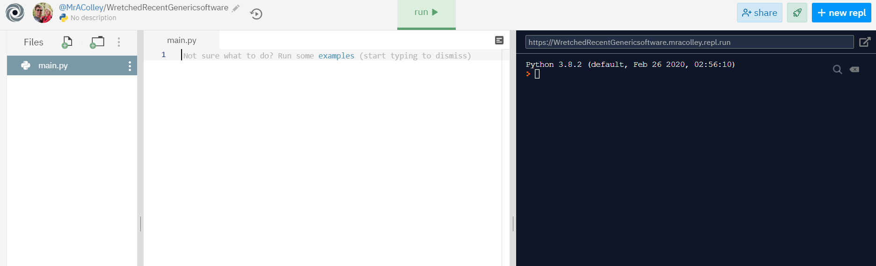
Choose ‘Fork’ here
Write your code here.
The console.
See what happens when you run your code here.
Notes:
Quick guide to the repl interface.
Explain what the console is black & white screen that produces text output – we’re not going to be coding graphics in this course – not quite at Madden/COD level yet.

Slide 11
OUTPUT

Slide 12
Programming – Output
Input
Data is collected and sent to the computer
Process
Carrying out instructions.
Output
Presenting the results of processing back to the user
print(“your text goes here”)
Notes:
The first command we’re learning is print - this makes the computer produce output (text on the console in this case).
Any text that is inside the brackets and speech marks gets ‘printed’ to the console.

Slide 13
Programming – Output - Investigate
print(“your text goes here”)
Syntax – The Way The Code Is Written
print – no capital p.
Brackets – after print and at the end.
Text must go in speech marks.
Incorrect syntax = broken code that won’t work = error!
Notes:
Unpicking the print statement
Students try the code in the IDE and run it to see what happens.
Investigate types of error – remove a bracket, capitalise Print, remove a speech mark. Also mis-spell text in speech marks to show that this isn’t a syntax error. As long as the syntax is right then print works like Ron Burgundy – if it’s in the speech marks it goes on the screen.

Slide 14
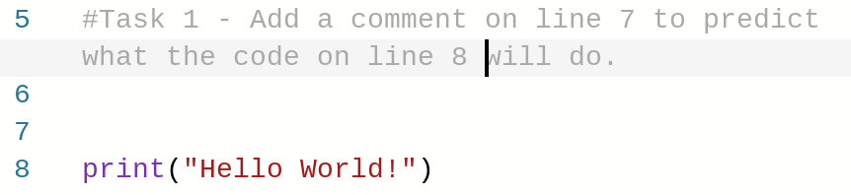
Programming – Output – Predict & Run
Add comments to the code to predict exactly what it will output.
Run the code to see if you were correct.
Notes:
Predict – students look at code and add comments to predict what it will do. Use this to teach how to add comments.
Insist on precision in prediction – they must include the capitals, exclamation mark etc.
Run to check predictions

Slide 15
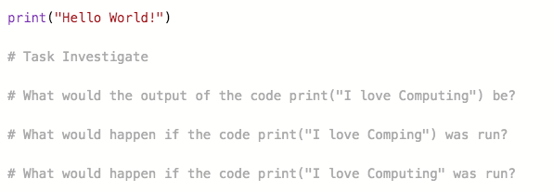
Programming – Output – Investigate
Add comments to the code to answer the questions.
https://repl.it/@MrAColley/11-Output
Notes:
Predict – students look at code and add comments to predict what it will do. Use this to teach how to add comments.
Insist on precision in prediction – they must include the capitals, exclamation mark etc.
Run to check predictions

Slide 16
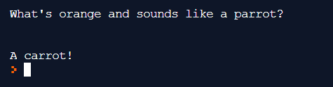
Programming – Output – Modify & Make
Modify – reuse the print statement to add your own single line message to the program.
Make – use the print statement to output a joke that appears on multiple lines (keep it clean!). Extra challenge – can you figure out how to add blank lines like in my joke?
Notes:
Modify & make.
This shouldn’t be that long of a section – hand over to any students who work out how to code a blank line to explain what they did.

Slide 17
VARIABLES

Slide 18

Programming - Variables
“blue”
Placeholders for information.
Can store one piece of information.
Can be called whatever you like (keep it relevant)
No spaces in the name.
Name starts with a lower case letter.
Can’t have 2 variables with the same name.
Use the variable name whenever you want to
output the information.
favColour
print(favColour)
print(“My favourite colour is “ + favColour)
Notes:
Variables are going to help us personalise our output messages.
Think of variables like envelopes – the actual information gets stored in the envelope.
The variable name goes on the front of the envelope.
The information goes ‘inside’ the envelope.
What’s different about this code? – Variable name is not in speech marks.
Concatenation – the + lets us join text to the contents of a variable. Pay attention to the space after is and before “
This link has an excellent video explanation of variables https://www.youtube.com/watch?v=G41G_PEWFjE

Slide 19
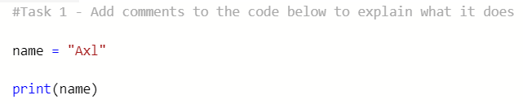
Programming – Variables – Predict & Run
Add comments to the code to predict exactly what it will output.
Run the code to see if you were correct.
Notes:
Predict – students look at code and add comments to predict what it will do. Use this to teach how to add comments.
Insist on precision in prediction – they must include the capitals, exclamation mark etc.
Run to check predictions

Slide 20
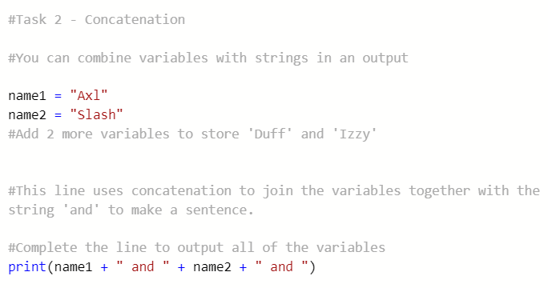
Programming – Variables – Modify
Notes:
Modify & make.
Concatenation is the term used for joining the contents of different variables and/or text in a single sentence. It uses the + operator which joins them together. We will see the + again used for a more familiar addition task in future weeks.
Create 2 new suitably named variables & assign.
Use concatenation to join them in a statement

Slide 21
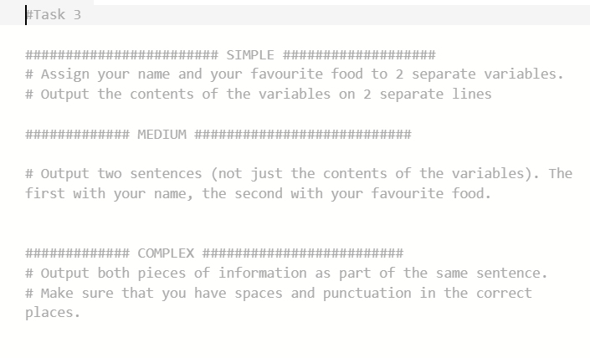
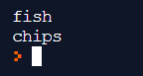
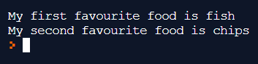
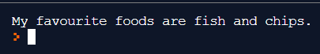
Programming – Variables – Make
https://repl.it/@MrAColley/13-Variable-Assignment-Challenge
Notes:
Make – practice assigning & concatenating.
Screenshots are examples of the output for each challenge.

Slide 22
INPUT

Slide 23
Programming – Input
Input
Data is collected and sent to the computer
Process
Carrying out instructions.
Output
Presenting the results of processing back to the user
print(“What’s your name?”)
name = input()
print(“Hello “ + name)
print(“What’s your name?”)
input()
Notes:
We can use input to start to interact with the user.
This will get input, but it won’t store it anywhere.
We can combine it with what we know about variables.
Whenever you get input, you MUST assign it to a variable. It’s one of the things that beginner coders ALWAYS forget.

Slide 24
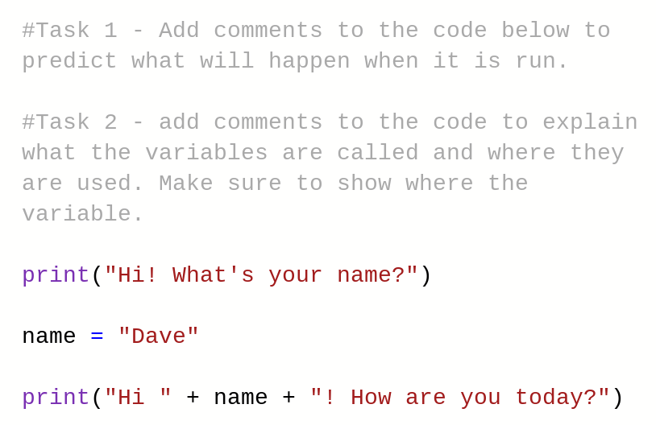
Programming – Input – Predict & Run
Add comments to the code to predict exactly what it will output.
Run the code to see if you were correct.
https://repl.it/@MrAColley/14-Input-With-Variables
Notes:
Predict – students look at code and add comments to predict what it will do. Useful to recap & check understanding of variables.
Insist on precision in prediction – they must include the capitals, exclamation mark etc.
Run to check predictions

Slide 25
Programming – Input - Efficiency
print(“What’s your name?”)
name = input()
name = input(“What’s your name?”)
Notes:
A more efficient way to combine input and output prompts.
The third line of code does the same job as the first two.
This makes our program more efficient as it uses less code.
We like efficient programs - we don’t have to write as much code, and the program is smaller which means it runs faster and takes up less storage space on our hard drive.
We did it the long way round at first to break it down and show students the separate commands.

Slide 26
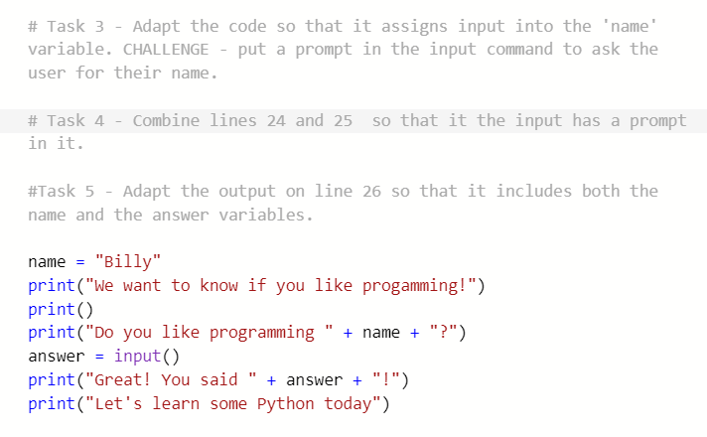
Programming – Input – Modify
Notes:
Modify & make.
Create 2 new suitably named variables & assign.
Use concatenation to join them in a statement
This program has a spelling error on the second line. Did your students spot it? Why didn’t it stop the code from running? It’s not a syntax error - an error in the way a command is typed. Any text in speech marks will be output whether there are spelling errors or not provided the print command is typed correctly.

Slide 27
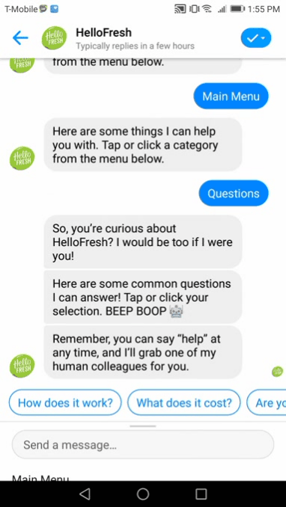
Programming – Variables – Make Homework
Chat-Bot Challenge
Lots of websites use chat bots to interact with their customers. These chat bots are often very sophisticated and use AI to learn and adapt to the user. Our chat bot is going to be a bit simpler.
The chat bot should work like this:
Ask the user their name and store it in a variable.
Greet the user by name.
Ask the user three questions about themselves and store their responses in three different suitably named variables.
Respond to each of the questions one by one, using the user’s name in the response.
Output a summary of all of the user’s answers in a single sentence.

